Slide 1
Decision Tree

Slide 2
Decision Tree
A Visual Representation of Choices, Consequences, Probabilities, and Opportunities. • A Way of Breaking Down Complicated Situations Down to Easier-to-Understand Scenarios. • By applying - Logic - Likely Outcome - Quantitative decision

Slide 3
Properties
Non-linear classifier
Easy to use
Easy to interpret
Susceptible to overfitting but can be avoided.

Slide 4
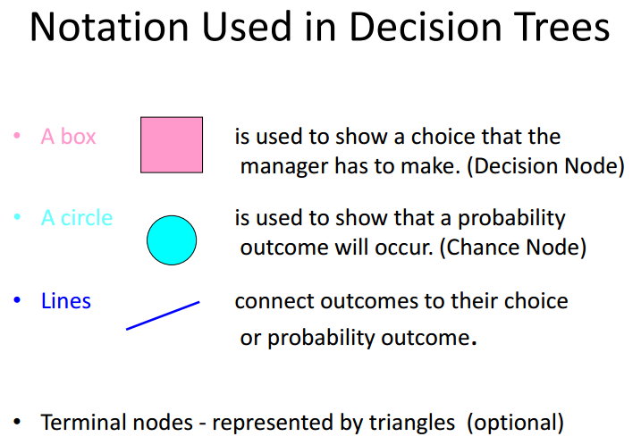
Notation

Slide 5
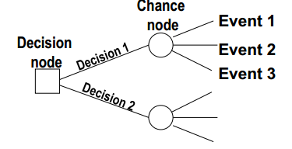
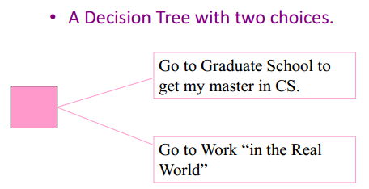
Example

Slide 6
How to solve a problem?
Solving the tree involves pruning all but the best decisions at decision nodes, and finding expected values of all possible states of nature at chance nodes
Works like a flow chart
All paths - mutually exclusive

Slide 7
Example
Mary is the CEO of a gadget factory. She is wondering whether or not it is a good idea to expand her factory this year. The cost to expand her factory is $1.5M. If she expands the factory, she expects to receive $6M if economy is good and people continue to buy lots of gadgets, and $2M if economy is bad. If she does nothing and the economy stays good she expects $3M in revenue; while only $1M if the economy is bad. She also assumes that there is a 40% chance of a good economy and a 60% chance of a bad economy.

Slide 8
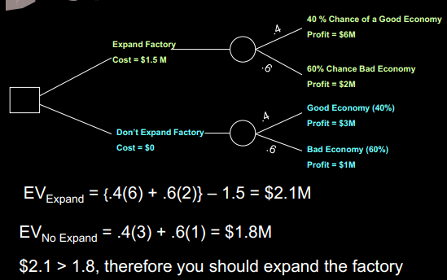
Example Continued

Slide 9
Steps to make up a decision tree
A. Draw the Diagram B. Use quantitative data i. Payoff Table and Probability ii. Decision under uncertainty iii. Expected Return iv. Expected value of perfect information

Slide 10
Example
Jenny Lind is a writer of romance novels. A movie company and a TV network both want exclusive rights to one of her more popular works. If she signs with the network, she will receive a single lump sum, but if she signs with the movie company, the amount she will receive depends on the market response to her movie. What should she do?

Slide 11
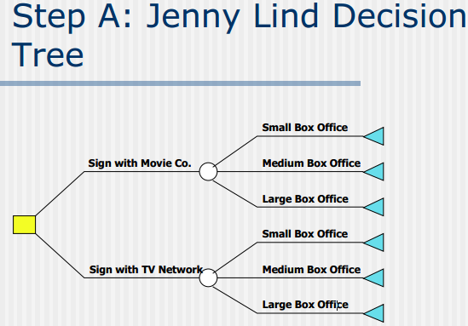

Slide 12
Payouts and Probabilities
■ Movie company Payouts  Small box office - $200,000  Medium box office - $1,000,000  Large box office - $3,000,000  TV Network Payout  Flat rate - $900,000  Probabilities  P(Small Box Office) = 0.3  P(Medium Box Office) = 0.6  P(Large Box Office) = 0.1

Slide 13
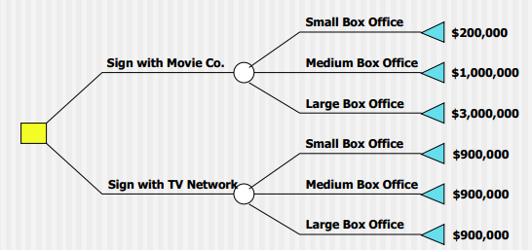
Step B: Use Quantitative
i. Data in Decision Tree: Payoff

Slide 14
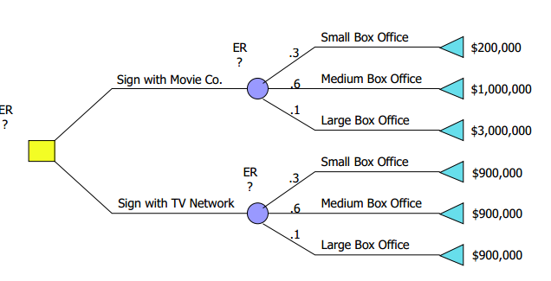

Slide 15
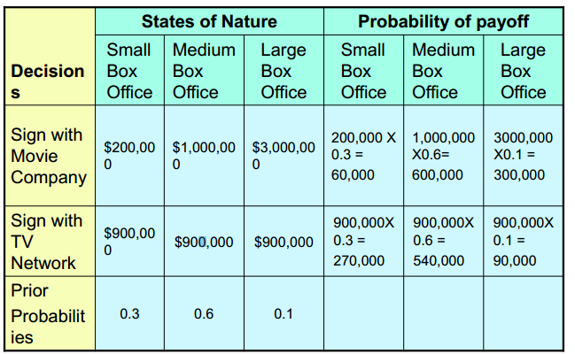
ii. Probability of payoff

Slide 16
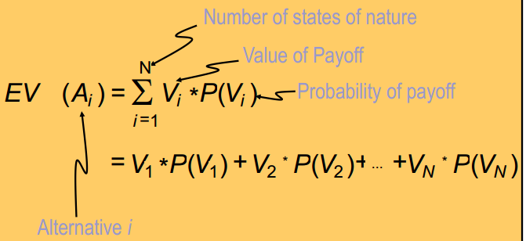
Expected Value Equation

Slide 17
iii. Expected Return Criteria EVmovie = 0.3(200,000)+0.6(1,000,000)+0.1(3,000,000) = $960,000 = EVBest EVtv = 0.3(900,000)+0.6(900,000)+0.1(900,000) = $900,000 Select alternative with largest expected value(EV). Therefore, using this criteria, Jenny should select the movie contract.

Slide 18
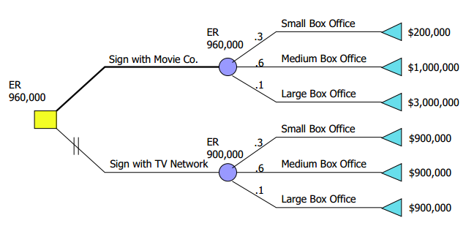
Jenny’s decision is only going to be made one time, and she will earn either $200,000, $1,000,000 or $3,000,000 if she signs the movie contract, not the calculated EV of $960,000!! Nevertheless, this amount is useful for decision making, as it will maximize Jenny’s expected returns in the long run if she continues to use this approach.

Slide 19
iv. Expected Value of Perfect Information (EVPI)
EVPI places an upper bound on what one would pay for additional information.
EVPI is the maximum you should pay to learn the future.
EVPI is the expected value under certainty (EVUC) minus the maximum EV.
EVPI = EVUC - maximum EV
Expected Value of Perfect Information (EVPI) What is the most that Jenny should be willing to pay to learn what the size of the box office will be before she decides with whom to sign?
EVPI Calculation EVwPI (or EVc) = 0.3(900,000)+0.6(1,000,000)+0.1(3,000,000) = $1,170,000
0.3(max(200,000 and 900,000))+0.6(max(1,000,000 and 900,000))+0.1(max(3,000,000 and 900,000))
EVBest = 0.3(200,000)+0.6(1,000,000)+0.1(3,000,000) = $960,000 EVPI = $1,170,000 - $960,000 = $210,000 Therefore, Jenny would be willing to spend up to $210,000 to learn additional information before making a decision.

Slide 20
Using Decision Trees
■ Scientific analysis to decision making  visual aids to structure  solve sequential decision problems  Especially beneficial when the complexity of the problem grows  Useful for operational decision making  Encourage clear thinking and planning

Slide 21
Decision Tree Limitations
■ local optimal solution not global optimal solution  Possibility of duplication with the same sub-tree on different paths  Possibility of spurious relationships

Slide 22
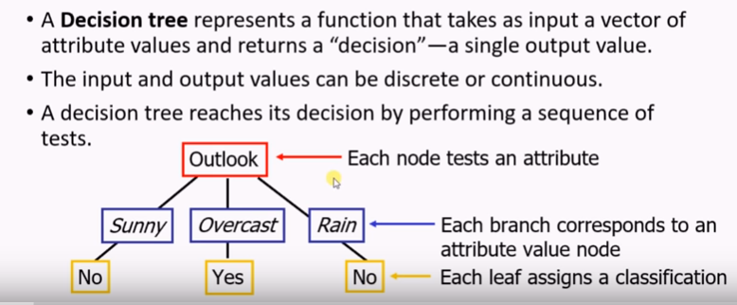
Decision Tree Learning

Slide 23
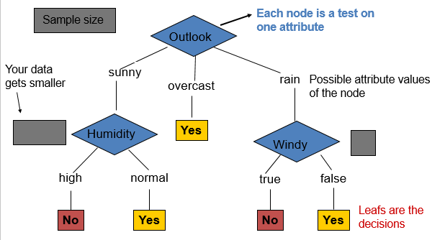
Anatomy of a decision tree

Slide 24
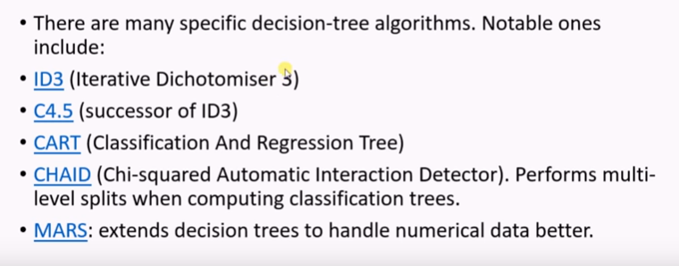
Decision Tree Learning Algorithms

Slide 25
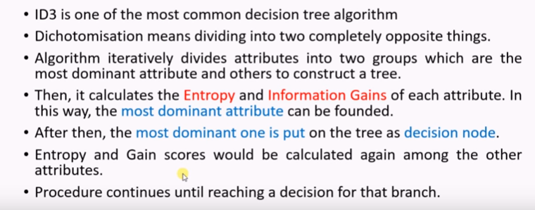
ID3 Algorithm

Slide 26
Information
If the probability of this event happening is small and it happens
the information is large.
Observing the outcome of a coin flip
is head
Observe the outcome of a dice is
Information:
reduction in uncertainty (amount of surprise in the outcome)
Notes:
A
C B
C
B A
A

Slide 27
Entropy
If there X can have 8 outcomes and all are equally likely
bits
The expected amount of information when observing the output of a random variable X

Slide 28
Information gain
Reduction in uncertainty by knowing Y
Information gain:
(information before split) – (information after split)
IG(X,Y)=H(X)-H(X|Y)

Slide 29
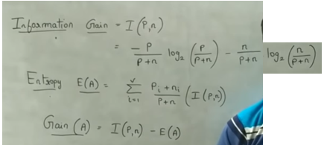

Slide 30
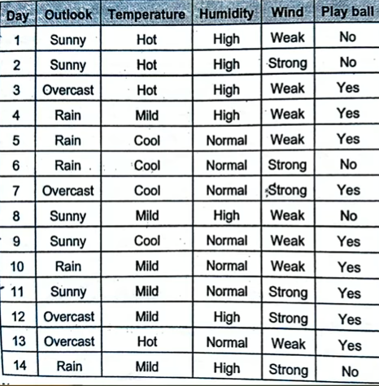
Example
Play ball->P=9(Yes) & n=5(No)

Slide 31
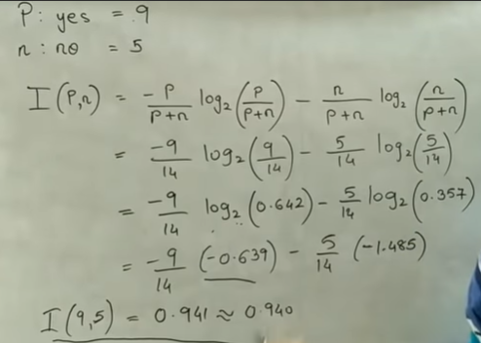
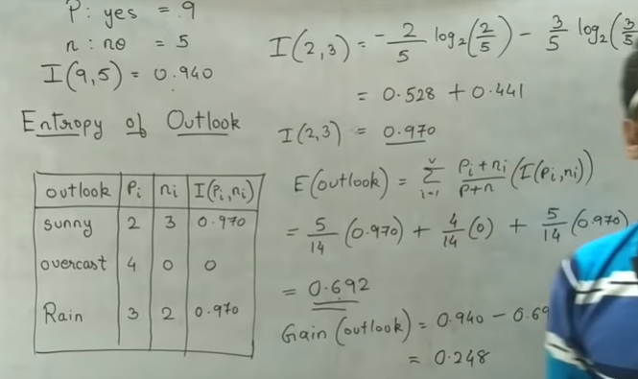

Slide 32
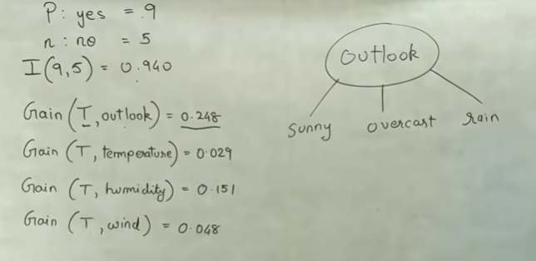

Slide 33
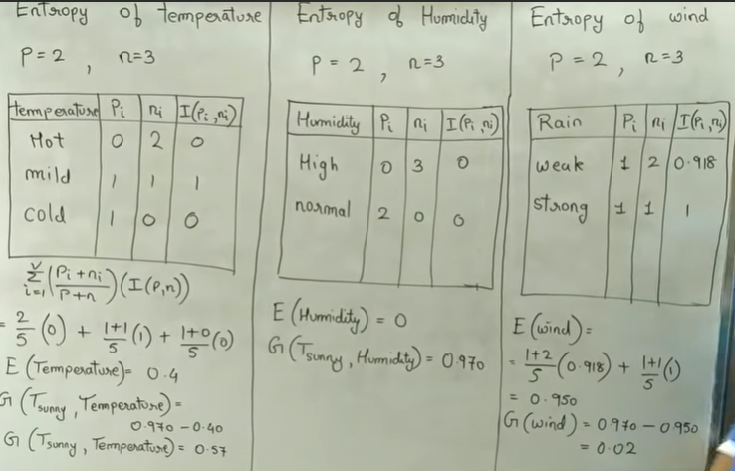
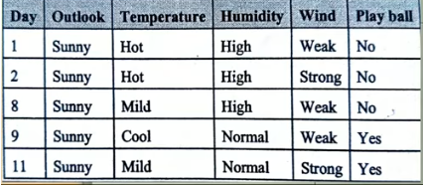

Slide 34
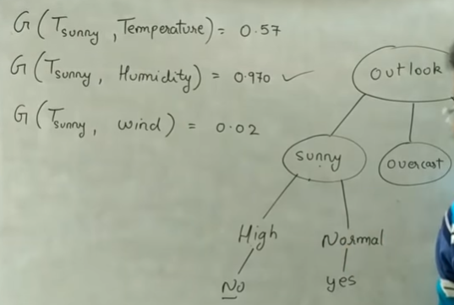
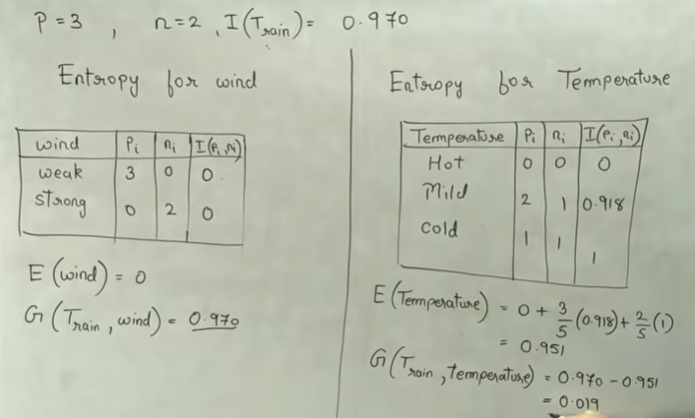

Slide 35
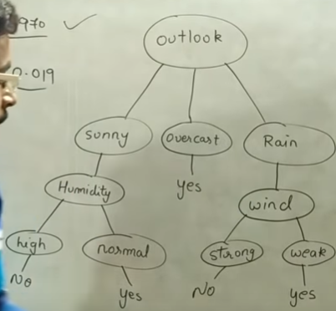
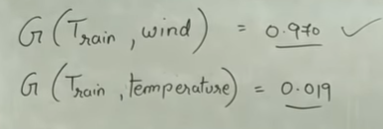

Slide 36
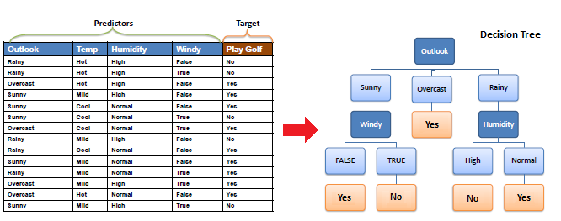

Slide 37
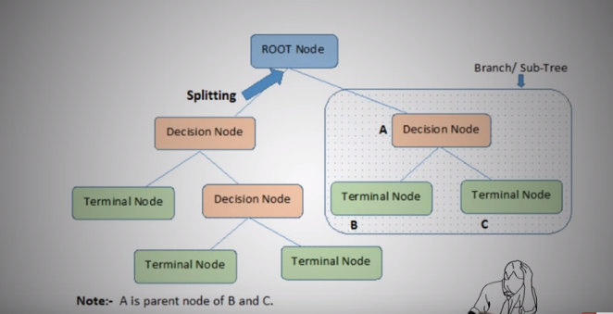
CART Algorithm

Slide 38
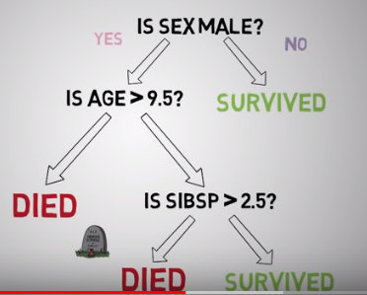

Slide 39
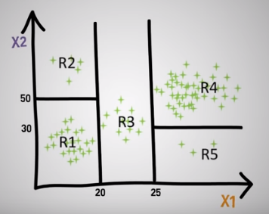
Example

Slide 40
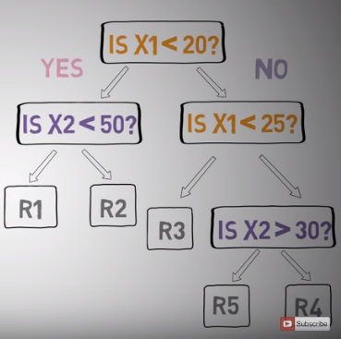

Slide 41
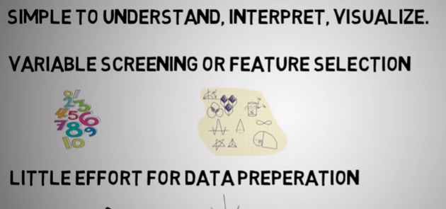
Pros of DT

Slide 42
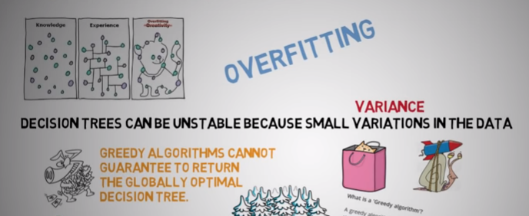
Cons of DT

Slide 43
Reference
https://www.youtube.com/watch?v=cKl7WV_EKDU&list=PLHmN7Pq-WTcz3F1pY3IzcZlJyS05jASob
https://www.youtube.com/watch?v=DCZ3tsQIoGU&list=PLHmN7Pq-WTcz3F1pY3IzcZlJyS05jASob&index=2

